Slide 1
Amazon sales data analysis

Slide 2
Objective:-
Development of Dashboard by Extracting-Transforming-Loading of data which contains Sales trend with respect to Year,Month,Quarter and find Some relationships through data to understand and Analyse the Facts.
Benefits:-
Gives better understanding about sales data
Gives idea regarding sales by Items,Customer,Sales representative, Lines
Helps better financial management.
Illustrates key matrices responsible for Sales.

Slide 3
Data Sharing Agreement :
Sample file :- SALESDATA.XLSX
Length of date stamp(8 digits):
Length of time stamp(6 digits):
Number of Columns: 14
Column names: CustKey, DateKey, Discount Amount, Invoice Date, Invoice Number, Item Class, Item Number, Item, Line Number, List Price, Order Number, Promised Delivery Date, Sales Amount, Sales Amount Based on List Price, Sales Cost Amount, Sales Margin Amount, Sales Price, Sales Quantity, Sales Rep, U/M
Column data type:int64, datetime64[ns], float64, datetime64[ns], int64, object, object, object, int64, float64, datetime64[ns], float64, float64, float64, float64, float64, int64, int64

Slide 4
ARCHITECTURE
Start
Data Gathering
Data Cleaning
Data Transformation
Generating Statistical Insights, Observations and Conclusions
Preparing PowerBI Dashboard
Data Visualization
Setting Up PowerBI for Visualization
Publishing Dashboard on Powerbi Server
End

Slide 5
Data Gathering:-
For Amazon sales data analysis data dataset provided with the link.
Imported provided data in Powerbi desktop in order to analyse and designing of dashboard to find key insights from the data.
Data Cleaning:-
I cleared all missing values from the data.
I removed unnecessary column from the dataset which were of no use for analysis.

Slide 6
Data Transformation
In order to get some key insights from data I made new calender table using dax functions.
In order to get some key insights from data I made new measures using dax functions given as follows:-
Calculations
Total discount
Total Sales amount
Total of Sales amount based on List price
Discount percentage
Specific Scenario
Top 5 Customers sale
Top 5 Item sales
Top 5 lines sales
Top 5 Representative sales
Made new Calculated column using dax functions for Categorising delivery into three categories as follows:-
On time delivery
Early delivery
Late delivery

Slide 7
Data Visualisation
Data visualization is the graphical representation of information and data. By using visual elements like charts, graphs, and maps, data visualization tools provide an accessible way to see and understand trends, outliers, and patterns in data.
Data Visualized by Using following visualizations:-
Total Sales, Discount Percentage, Sales Quantity- Card
Year Selection, Month Selection, Quarter Selection - Slicer
Total Sales by Month - Area Chart
Top 5 item sale, Top 5 customer sale, Top 5 sales representative, Top 5 line sales – Table
Total sales of Item, Total sales of customer, Total sales of sales representative , Total sales of lines- Clustered Column Chart
Count of invoice number by delivery , Count of item by U/M – Pie Chart
Item Names - Chicklet Slicer (Custom Visual)
Total Sales Vs Total Discount , List price vs Sales price – Clustered Column Chart
Sales quantity vs delivery , Sales margin amount vs Sales amount – Line Chart

Slide 8
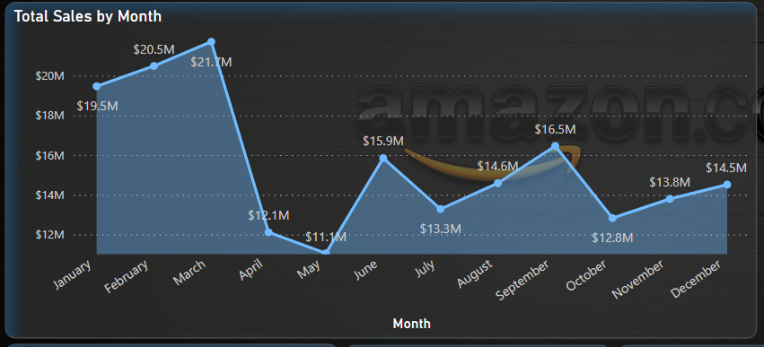
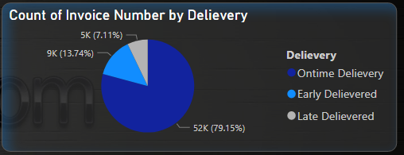
Statistical Insights from Data
For total sales throughout all the years March month sale is on higher side
In delivery section On time deliveries are 79.15% which leads to customer satisfaction and increase in sales

Slide 9
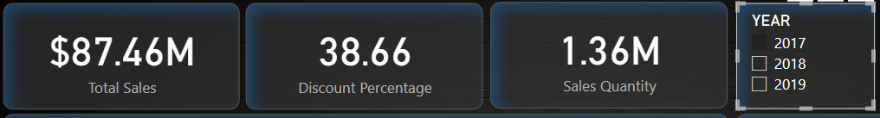
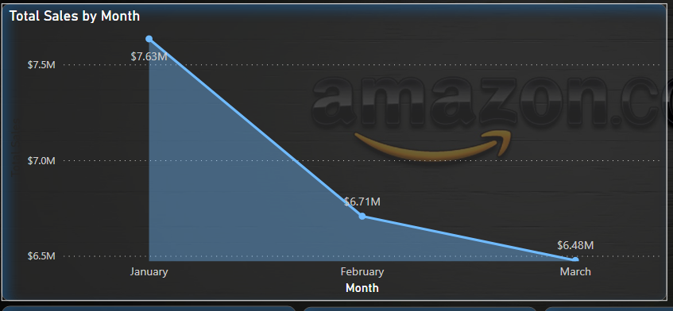
Statistical Insights from Data
Year 2017 is the year with highest sales of 87.46 million dollars.
In year 2018 Sales took place for 3 months which is 20.82 million dollars only leaded to decrease in overall sales.

Slide 10
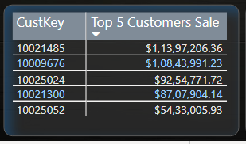
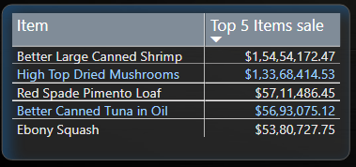
Statistical Insights from Data
Out of 615 customers, Customer with customer id "10021485" gave highest sales to company for each year. By giving some facilities to customer like this company sale can increase further.
Out of 657 items ,"Better Large Canned Shrimp" is the item which gave highest sales for each year even in year 2018. So increase in price of it by some percentage can give more sales to company.

Slide 11
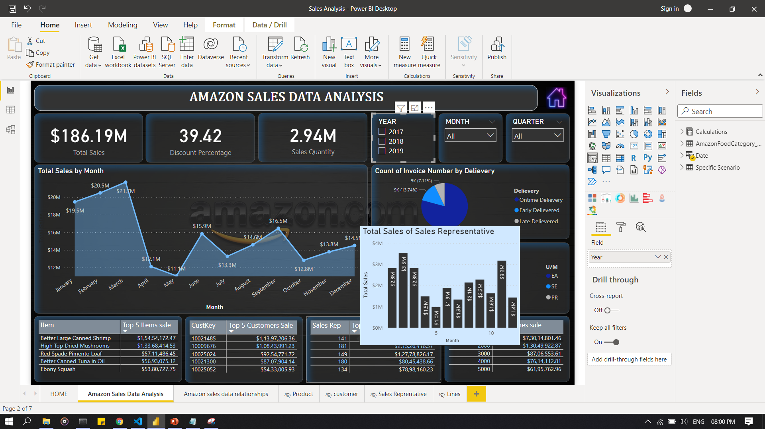
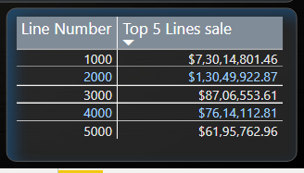
Statistical Insights from Data
Out of 64 sales representatives, Sales representative with id "141" gave highest sales to the company for the year of 2017 and 2019
Out of 397 lines, line with line id "1000" gave highest sales to company for each year.

Slide 12
Q & A:
From where the dataset selected
Ans:- Link were given in project problem statement from internship document.
https://drive.google.com/drive/folders/1FkmFVL8wlJmQWP1z52TD8PlhOJhitTyI
2.What are the datatypes in dataset?
Ans:-Datatypes are as given below-
int64, datetime64[ns], float64, datetime64[ns], int64, object, object, object, int64, float64, datetime64[ns], float64, float64, float64, float64, float64, int64, int64
3.What is the total sales by Amazon for all 3 years?
Ans:- Total sales for all three year was 186.19 Million Dollars with 39.42% discount
4.What are the techniques used before making dashboard?
Ans:-Please refer slide no. 4
5.Is data used as it provided?
Ans:- No, Some measures as well as Calculated column made in the dataset for insights purpose.
for more details please refer slide no. 5

Slide 13
Thank You……………

